Slide 1
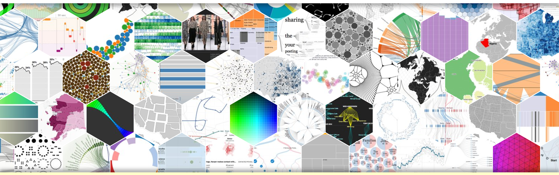
D3
Kevin Zheng

Slide 2
What is D3?
Data-Driven Document
A JavaScript library.
Has unique functions for mapping data to a visual graph.
We will create a bar graph and extra fun time.
Transforms raw data to efficient communication.

Slide 3
Transforming raw data to efficient communication.
Imagine you have a large raw data like this: https://raw.githubusercontent.com/torkian/HW4/master/data/data.json
55029 Objects
This is our data:
https://drive.google.com/drive/folders/1-Hp8cU2lGTevcgWpjrZOqsTEe_emDn4M
12 objects

Slide 4
Concepts And Terms
DOM, Document Object Model (DOM): programming interface for HTML documents
Data Binding: attaching” or associating data to specific elements. If we don’t attach data to an elements then it won’t show up in the web browser.
SVG: The canvas where we'll draw the bar graph.

Slide 5
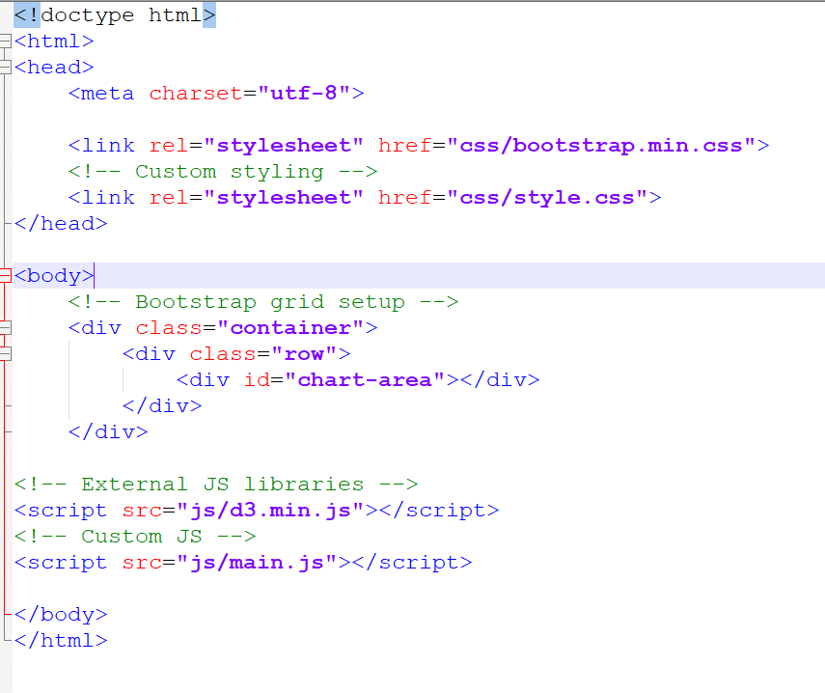
Elements Tags

Slide 6
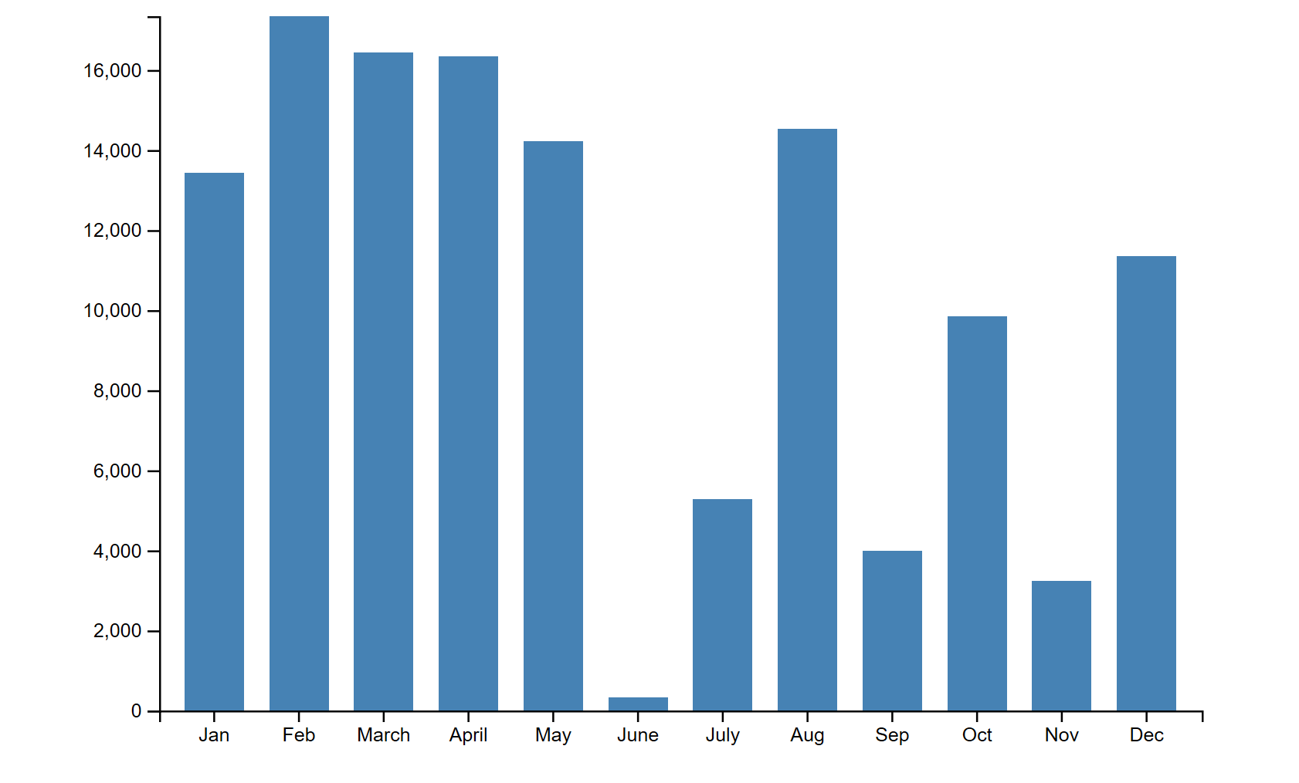

Slide 7
SVG
Go to example

Slide 8
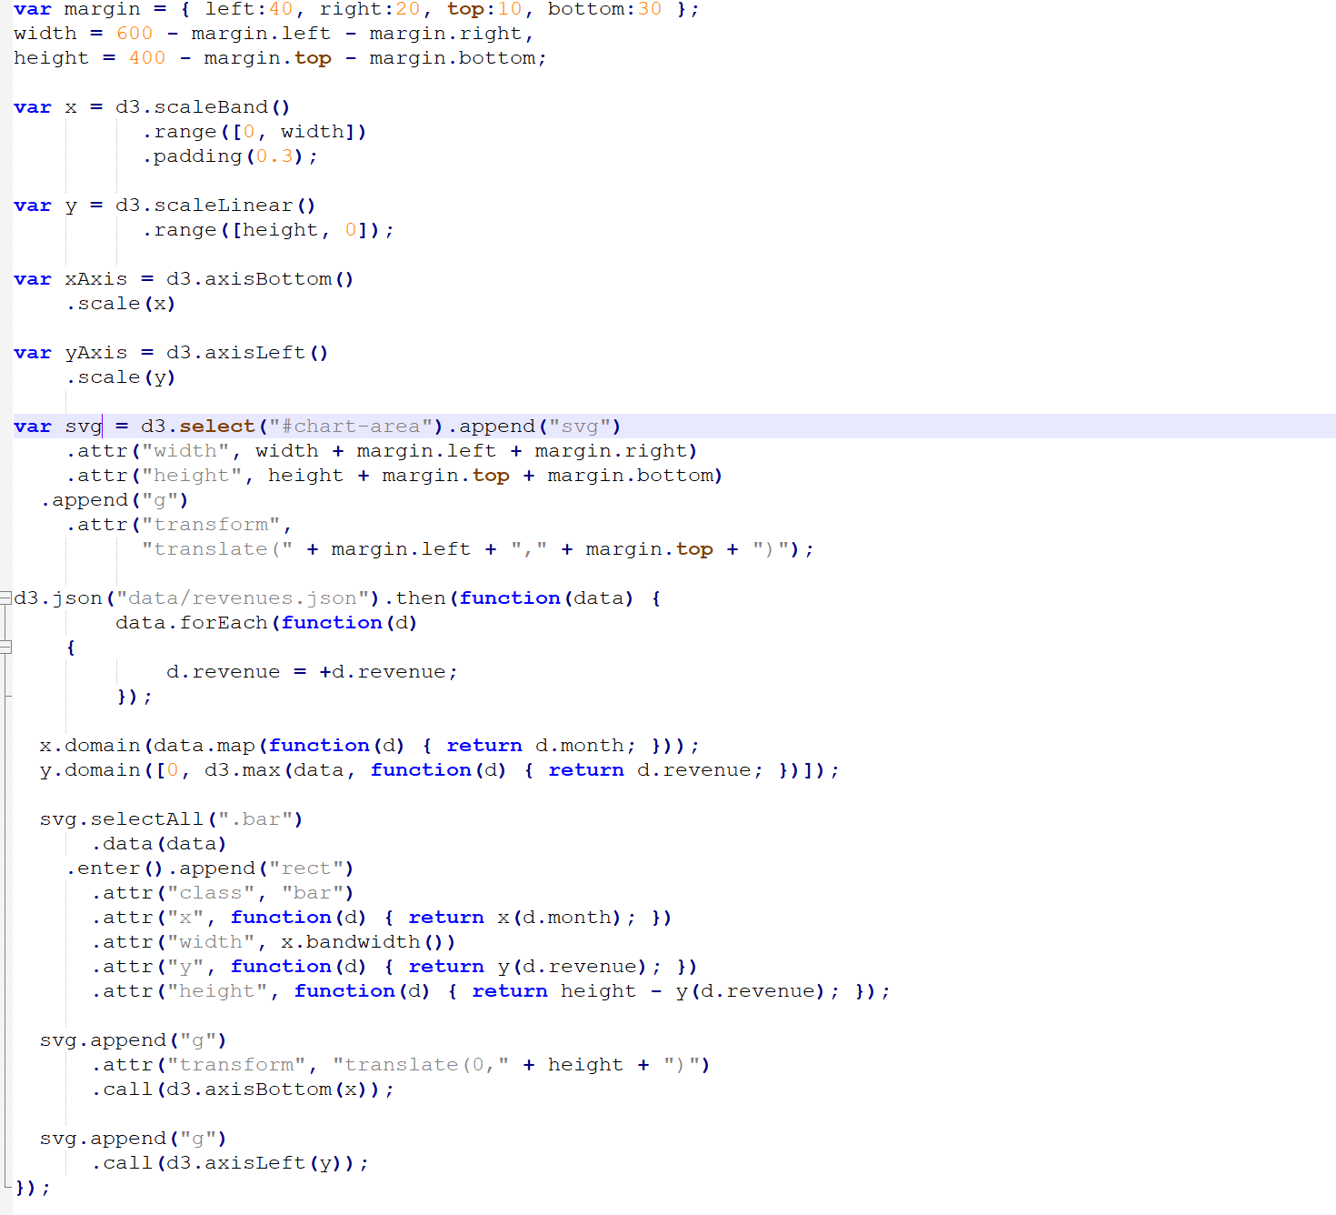

Slide 9
Extra Fun Time
https://codepen.io/CodeKevin42/pen/eoQppR

